Slide 1
Securing your Infrastructure with Azure Sentinel
Subtitle or speaker name
Notes:
Welcome to Securing your Infrastructure with Azure Sentinel.
My name is [Speaker name].

Slide 2
Agenda
Azure Sentinel data
Analytics
Visualize
Security orchestration
Notes:
Today we'll be running through Azure Sentinel from a few different lenses. If you've already deployed Azure Sentinel, some of this might be a repeat but I'll call out best practices where possible.
We'll start with Azure Sentinel data, including data storage in Log Analytics and how to approach workspace design in both a single tenant and multi-tenant environment. Next we'll cover the various sources of data that are available for ingestion into Log Analytics and analysis through Azure Sentinel and how that data can be encrypted.
Then, we'll talk about what you can do with your data once it's being ingested into Log Analytics. This includes leverage built-in detection rules and creating your own custom rule templates.
After that, we'll review visualizations and what you can do with Workbooks in Sentinel.
And finally, we'll close with Security Orchestration, Automation and Response, or SOAR.

Slide 3
Azure Sentinel data
Notes:
Let's get started with Azure Sentinel data sources.

Slide 4
Workspace considerations
Tenant
Single
Multiple
Data governance
Costs
Bandwidth
Storage
Notes:
The first thing we need to think about before we enable Sentinel is what workspace (or workspaces!) it is going to be enabled in. There's a lot of nuance here with single vs multi-tenant considerations and how data is governed and how costs manifest for both bandwidth and storage across your solution stack.
If you have multiple workspaces for performance, resiliency, or data sovereignty – are there any pitfalls to incident or alert correlation you need to be aware of? As you onboard other solutions or even as new functionality is added to existing solutions like Azure Security Center you need to understand where that data is going to reside and if it generates incidents, how are you going to keep the alert noise low?

Slide 5


Workspace Design (Single Tenant) One single workspace per tenant – many customers can do this today!
Pros
Central pane of glass
Consolidates all security logs and information
Easier to query all information
Supported by all features of Azure Sentinel
Azure Log Analytics RBAC to control data access
Azure Sentinel RBAC for service RBAC
Cons
Data governance may drive limited scope
Can incur bandwidth cost cross region

Slide 6
Workspace Design (Single Tenant) Regional workspaces
Pros
No cross-region bandwidth cost
May be required to meet regulation requirements
Separate workspaces can add even more data control
Cons
No central pane of glass
Analytics, Workbooks, etc. must be deployed multiple times

Slide 7
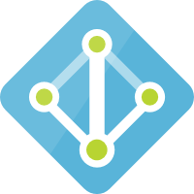




Workspace Design (Single Tenant)
Tenant
Tenant
Subscription
Subscription
Resource Group
Resource Group Region A
Resource Group Region B
Workspace
Azure Sentinel
Workspace
Azure Sentinel
Workspace
Azure Sentinel

Slide 8
But what if I have multiple tenants?
Contoso |  |  |  |  | Northwind |  |  |  | Coho Winery
 |  |  |  |  | CENTRAL & SW | Prod. |  |  | Prod. | Staging | Test | Dev.
SALES, MKTG, & SERVICE |  | Prod. | QA | Dev. | EAST | Prod. |  |  | Prod. | Staging | Test | Dev.
LEGAL |  | Prod. | QA | Dev. | INCUBATION TEAM | Prod. |  |  | Prod. | Staging | Test | Dev.
HR |  | Prod. | QA | Dev. | NORTHWEST | Prod. | QA | Dev. | Prod. | Staging | Test | Dev.
Fabrikham |  |  |  |  | Proseware |  |  |  | Prod. | Staging | Test | Dev.
 |  |  |  |  |  |  |  |  | Prod. | Staging | Test | Dev.
VENDOR MGMT | Prod. | Training | Test | Dev. | VENDOR MGMT FOR REAL ESTATE | Prod. | Test/Dev. |  | Prod. | Staging | Test | Dev.
RETAIL | Prod. | Training | Test | Dev. | RETAIL | Prod. | Test/Dev. |  | Prod. | Staging | Test | Dev.
WEALTH MGMT | Prod. | Training | Test | Dev. | WEALTH MGMT | Prod. | Test/Dev. |  | Prod. | Staging | Test | Dev.

Slide 9
Workspace Design (Multi-Tenant) One workspace per tenant Use Azure Lighthouse to delegate access to the central tenant
Pros
Same as single workspace single tenant
Cons
No single pane across all tenants

Slide 10
Workspace Design (Multi-Tenant)
Optional, but not recommended
Ship logs from each tenant to a central tenant
Source → Event Hub → Logic App → Azure Log Analytics
https://docs.microsoft.com/azure/azure-monitor/platform/activity-log-collect-tenants
Incur costs for Event Hubs & Logic Apps
Data written via Logic App will be stored in a Custom Log (_CL)
Queries will have to be changed to support _CL

Slide 11
Workspace Design (Multi-Tenant)
Tenant A
Tenant B
Tenant C
Subscription
Subscription
Subscription
Resource Group
Resource Group
Resource Group
Workspace
Azure Sentinel
Workspace
Azure Sentinel
Workspace
Azure Sentinel
Azure Lighthouse

Slide 12



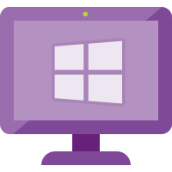
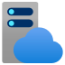


All the ways data gets in
Custom App
Appliances (Integrated)
Logic App – Send Data Connector
PUSH
Rest API
Threat Intelligence
(via Graph Security API)
MISP, Palo Alto….
Cloud Services
w/ Connector
O365, MCAS, AATP, MDATP, AWS
Workspace
Azure Sentinel
PULL
PUSH
Azure Services
(Diagnostic Logs)
AAD, AAD IP, Azure Activity, AIP, ASC, AzWAF, …
PUSH
Windows Agent
Linux Agent
Linux Agent – Configured for CEF
Appliances (CEF)
PUSH

Slide 13
Data Collectors (Quick Wins)
Enable 1st-party Connectors that are running in the environment
Most are free
O365
Azure Activity
1st Party Alerts – MCAS, AATP, MDATP, AAD IP
Connect AWS
Connect / Configure Azure Diagnostic Logs (Policy)
Deploy Windows/Linux Agent in Azure (built-in Policy)

Slide 14
Data Collectors (Next Steps)
Deploy Windows/Linux Agent
On-premises
Other clouds
Deploy CEF Collection
Configure CEF collector using configuration script
Configure source devices – ensure they support RFC and CEF
See the “Grand List” https://techcommunity.microsoft.com/t5/Azure-Sentinel/Azure-Sentinel-The-Syslog-and-CEF-source-configuration-grand/ba-p/803891
Integrate Threat Intelligence
Ask vendors to directly integrate!

Slide 15

CEF architecture
On prem
On prem
Syslog source
Syslog source
Syslog
Over UDP, TCP, or TLS default port: 514
Azure
Syslog source
Azure
Syslog source
Syslog agent
Syslog agent
Syslog source
Syslog daemon
(rsylog.d and syslog-ng)
Azure Sentinel agent
Azure Sentinel workspace
Syslog daemon
(rsylog.d and syslog-ng)
Azure Sentinel agent
Azure Sentinel workspace
Syslog source
UDP port: 25226
Restful API over TLS port: 443
UDP port 25226
Syslog source
Syslog source

Slide 16
Customer-managed key
All data saved or sent to Sentinel can be encrypted with CMK
Only available to new customers
Request at azuresentinelCMK@microsoft.com
Limited regions
East US
West US 2
South Central US
Larger workloads
1TB per-day or more of data ingested in Sentinel
Notes:
CMK enables all data saved or sent to Azure Sentinel to be encrypted in all relevant storage resources with an Azure Key Vault key created or owned by you or your customers. In the event that a user revokes the key encryption key, either by deleting it or removing access for Azure Sentinel, within one hour, Azure Sentinel will honor the change and behave as if the data is no longer available. At this point, any operation performed that uses persistent storage resources such as data ingestion, persistent configuration changes, and incident creation, will be prevented. Previously stored data will not be deleted but will remain inaccessible. Inaccessible data is governed by the data-retention policy and will be purged in accordance with that policy. The only operation possible after the encryption key is revoked or deleted is account deletion. If access is restored after revocation, Azure Sentinel will restore access to the data within an hour. You can also rotate keys by creating a new version of the key and within an hour Sentinel will begin using the new version.
CMK is provided only to customers who are new and access to this capability is controlled by Azure feature registration. You can request access by contacting azuresentinelCMK@microsoft.com, and as capacity is available, pending requests will be approved.
The Azure Sentinel CMK capability is only available in East US, West US 2, and South Central US regions and the CMK capability is only available to customers sending 1TB per day or more.
With CMK, you'll be encrypting the contents of the Log Analytics workspace Sentinel is enabled in as well as all of the other associated resources such as storage accounts for diagnostics storage collection with a key managed in Azure Key Vault.

Slide 17
Demo
Implementing customer managed keys for Azure Sentinel

Slide 18
Analytics

Slide 19

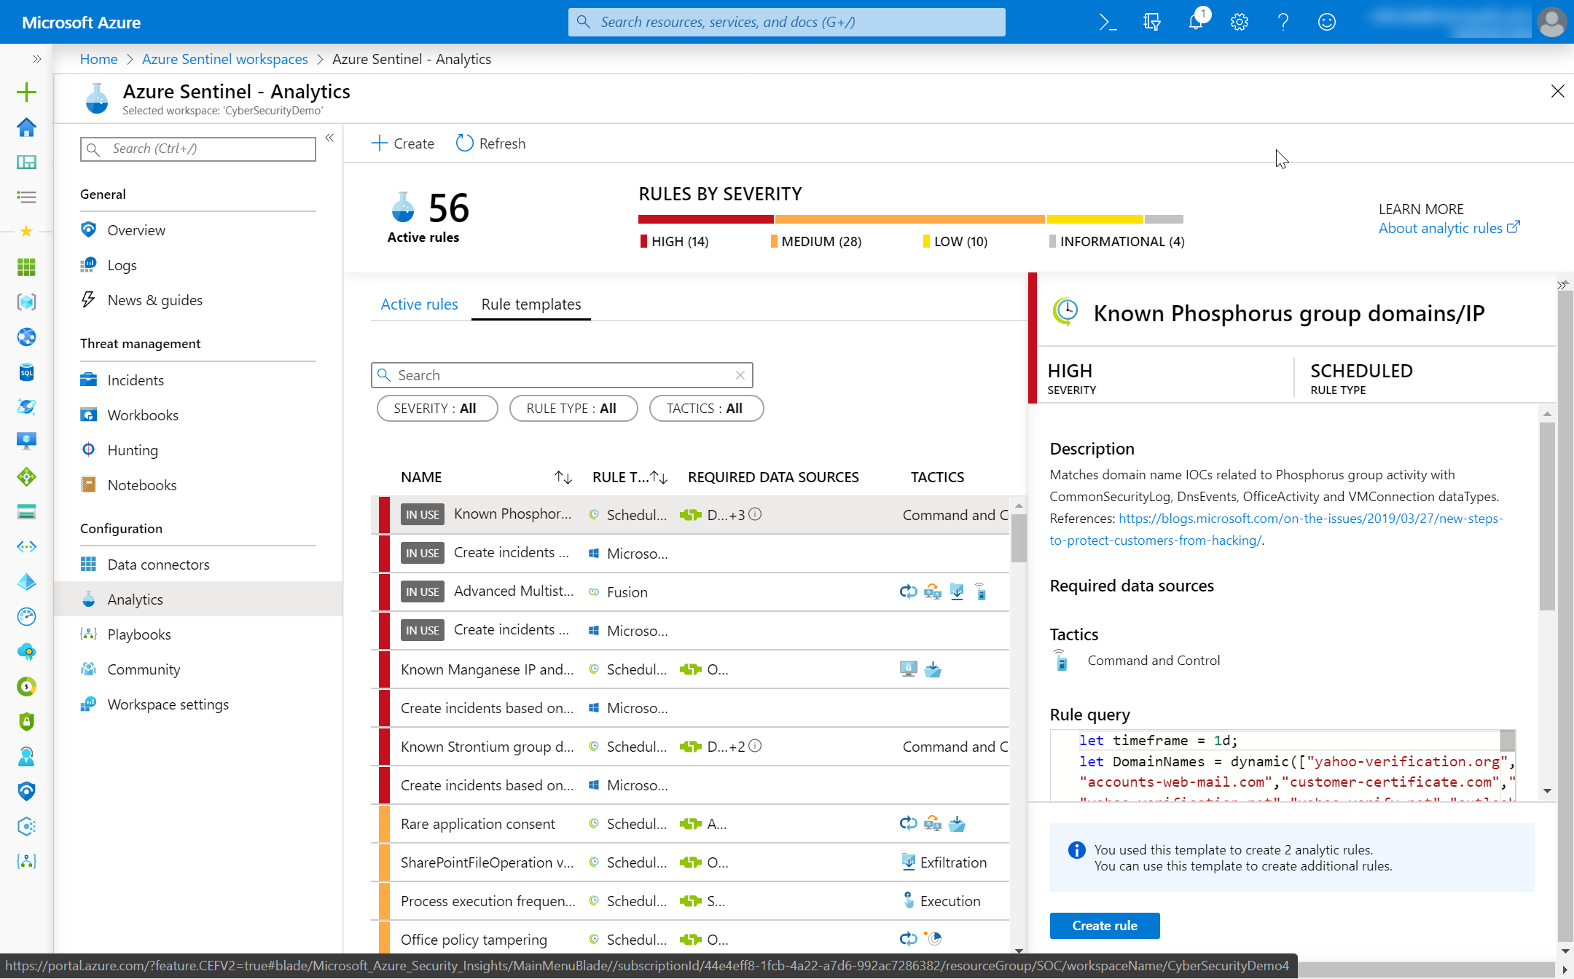
Analytics
You got data… now what?
Create Analytics to detect suspicious activity!
Enable Microsoft Security rules
Enable built-in rules
Use GitHub
Build custom detections

Slide 20
Built-in rules

Slide 21
Custom rules creation

Slide 22
Demo
Authoring custom rules

Slide 23
Alerts and automated threat response

Slide 24
Demo
API integrations with Microsoft Security Graph

Slide 25
Visualize

Slide 26
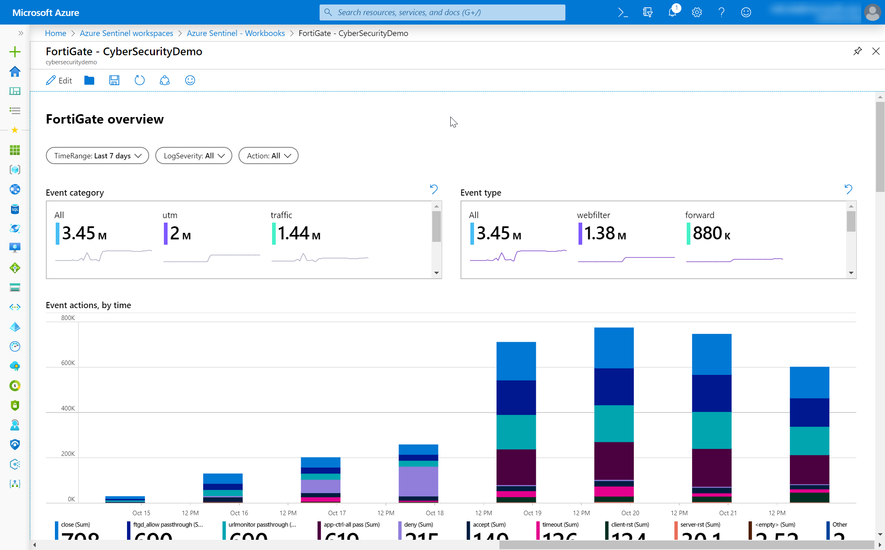
Data visualization
Monitor your data and activity
Use built-in workbooks
Use Power BI for external users

Slide 27
Create custom workbooks

Slide 28
Demo
Creating a custom workbook using Azure Monitor workbooks

Slide 29
Security orchtestration

Slide 30
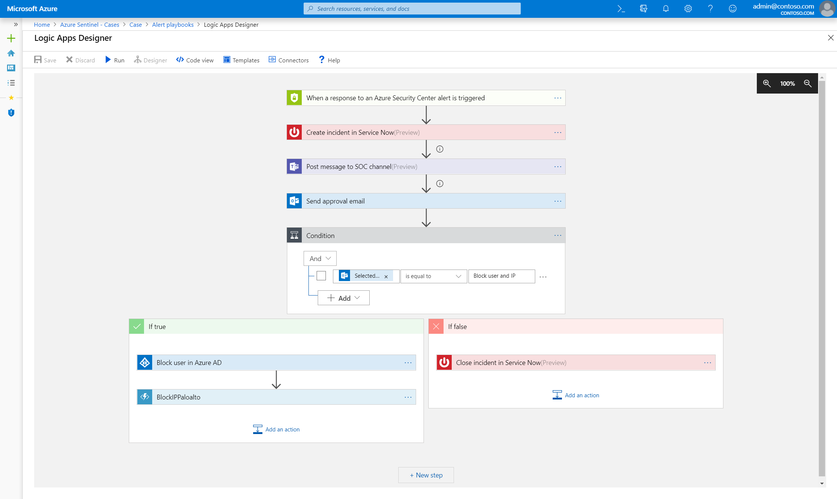
SOAR
Reduce your workload with automation
Use GitHub templates
…. and share your workbooks back!

Slide 31
Demo
Automating incident response with playbooks

Slide 32
Thank you.
Notes:
Thanks for listening to Securing your Infrastructure with Azure Sentinel.
My name is [Speaker name].

